Slide 1
The Promise: Bringing it all Together Building on our Past to Determine Tomorrow
An Analysis of the Racialized Opportunity Gaps Present in St. Louis Public Education

Slide 2
Timeline of Important Events in Missouri*
1976:
Missouri removes law mandating the separate education of black and white children from Constitution
1950-1970:
400,000 white residents leave St. Louis City for the Suburbs
100,000 African American move into St. Louis City
SLPS becomes overwhelmingly African American
2016
1954:
Brown v. Board of Education ends de jure school segregation
VICC Board votes to extend VICC for the last time
1955:
Brown v. Board II instructs states to dismantle segregated schools with “all deliberate speed,” but also gives states the power to delay desegregation if it is “necessary in the public interest.”
1972:
Liddell v. Board of Education of St. Louis is filed, the first step towards the creation of VICC
1999:
Settlement reached initiating phase out of VICC
1983-84:
First school year VICC
is operational
*Heaney and Uchitelle, 2004
Notes:
CENSUS DATa: 1950: 17.9% of city was black, 1960: 28.6%, 1970: 40.9%

Slide 3
The History of Segregation in the St. Louis Metropolitan Area
Notes:
Mapping Decline – St. Louis and the American City; Colin Gordon, The University of Iowa Libraries
Each map shows the demographic change between the two census years, each dot represents 10 people (go over colors)

Slide 4
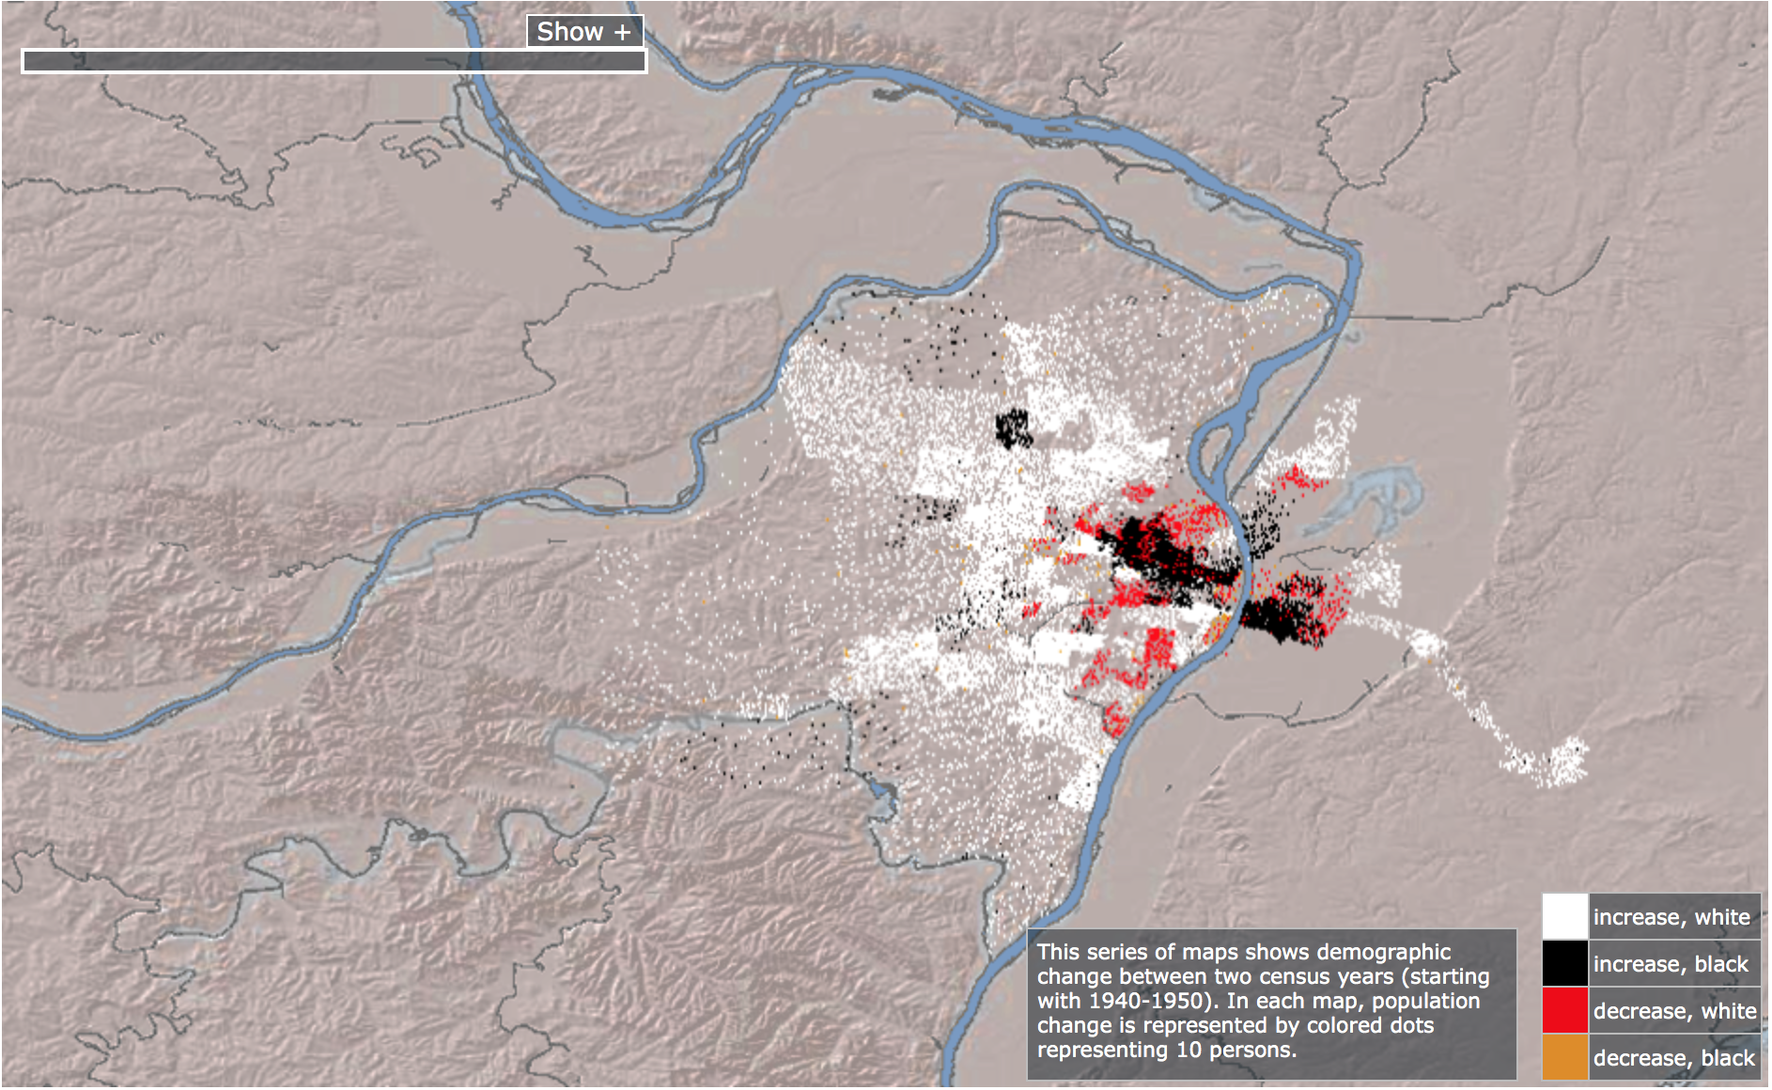
1940-1950:
Mapping Decline – St. Louis and the American City; Colin Gordon, The University of Iowa Libraries, Accessed Dec 3, 2017

Slide 5
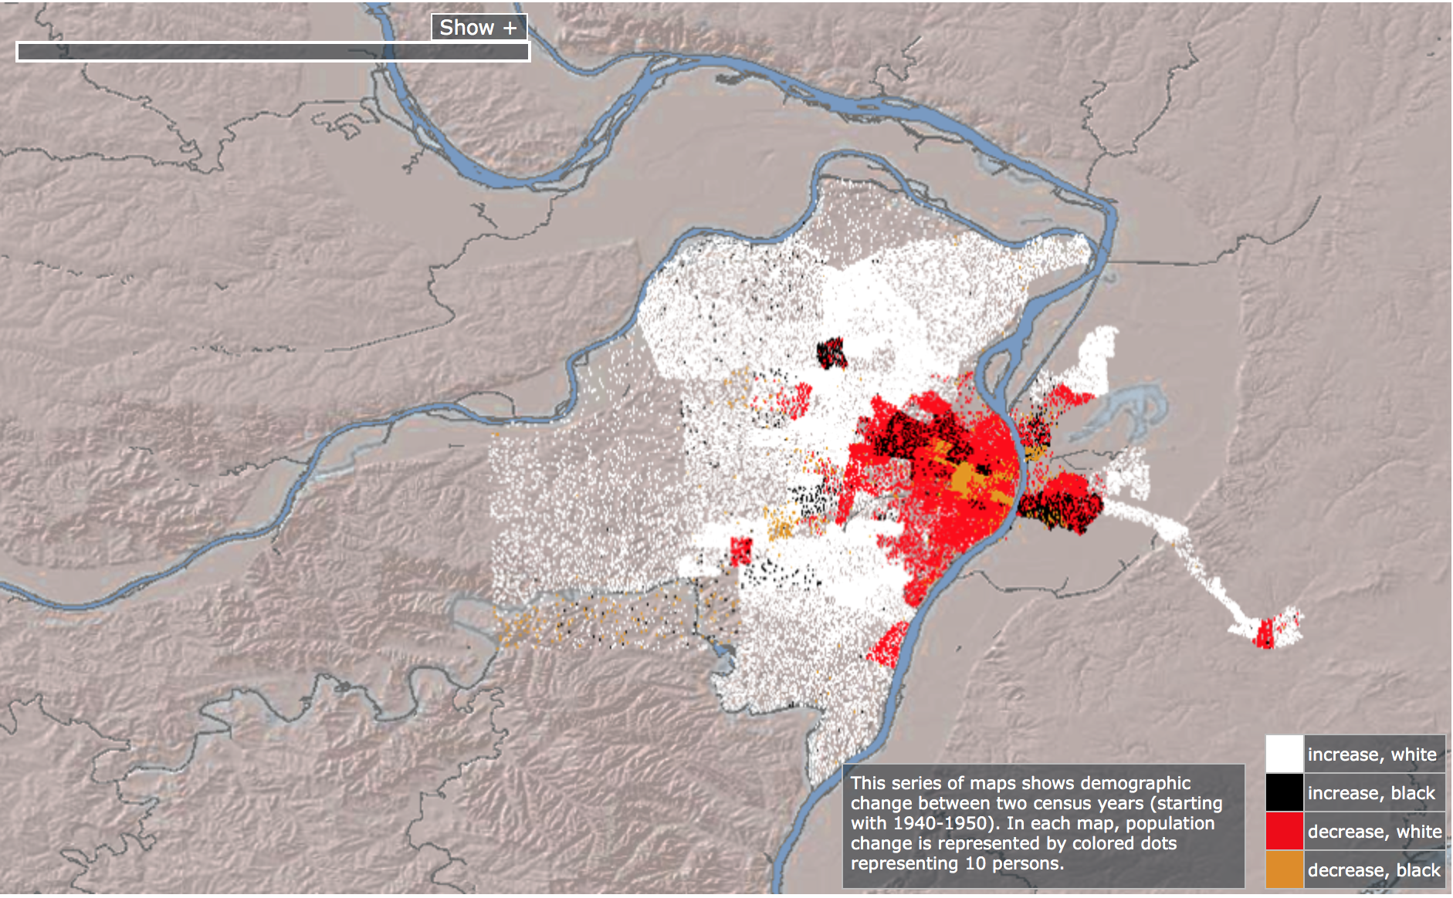
1950-1960:
Mapping Decline – St. Louis and the American City; Colin Gordon, The University of Iowa Libraries, Accessed Dec 3, 2017

Slide 6
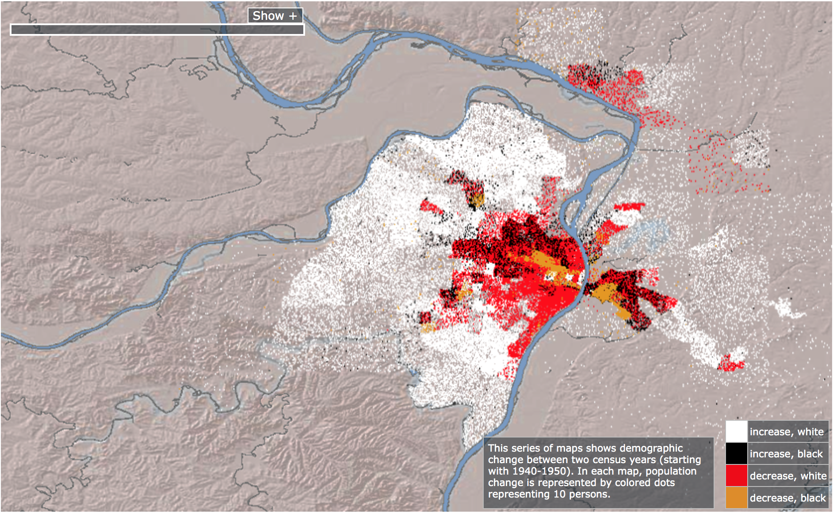
1960-1970:
Mapping Decline – St. Louis and the American City; Colin Gordon, The University of Iowa Libraries, Accessed Dec 3, 2017

Slide 7
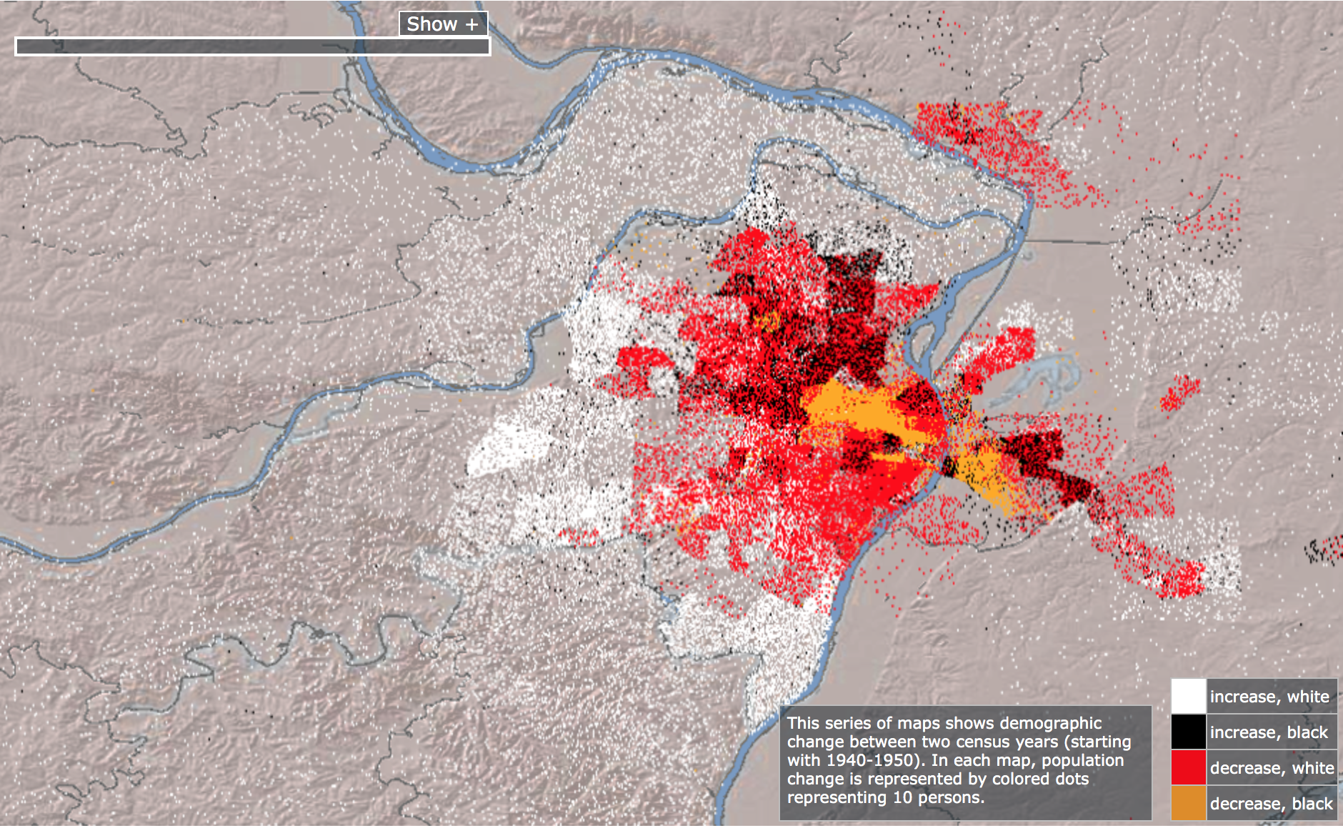
1970-1980:
Mapping Decline – St. Louis and the American City; Colin Gordon, The University of Iowa Libraries, Accessed Dec 3, 2017

Slide 8
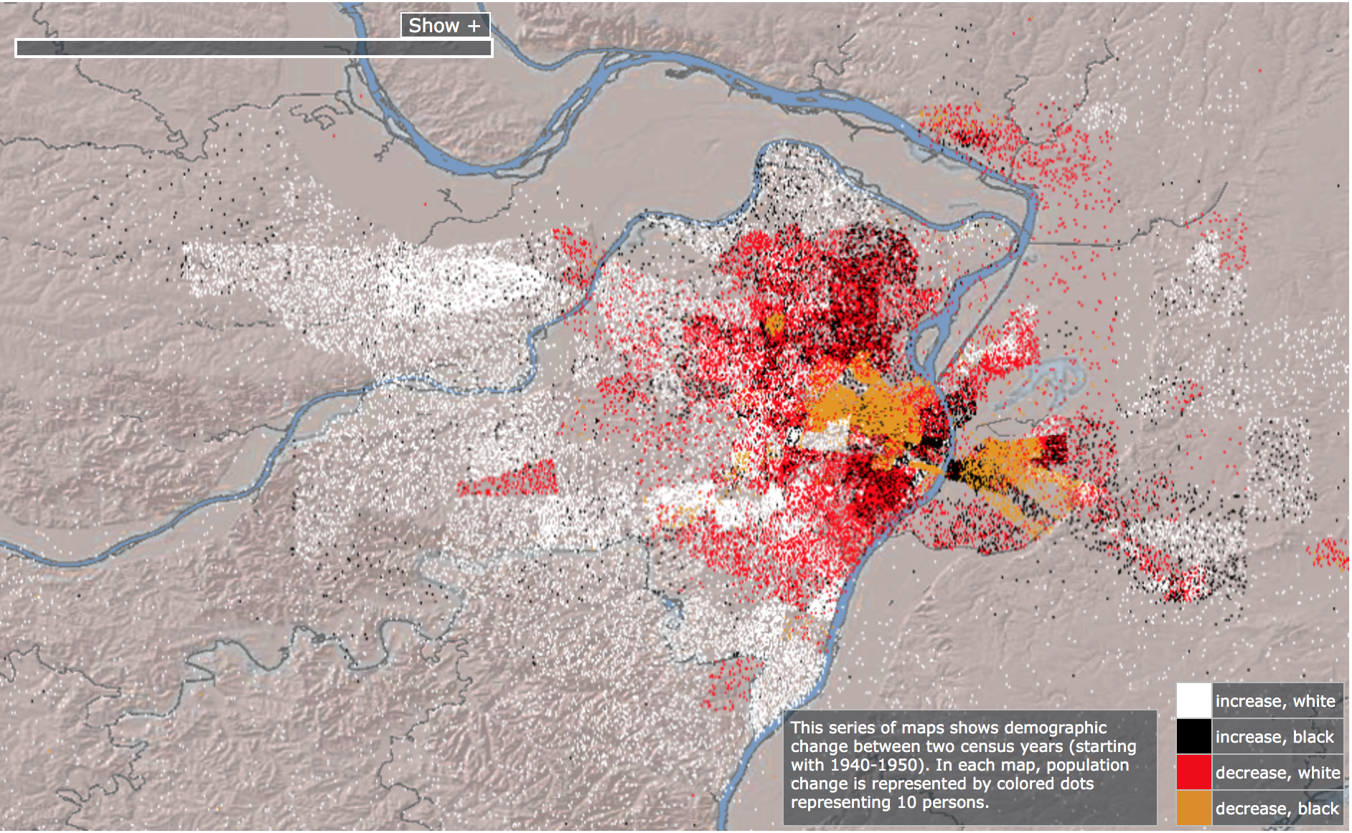
1980-1990:
Mapping Decline – St. Louis and the American City; Colin Gordon, The University of Iowa Libraries, Accessed Dec 3, 2017

Slide 9
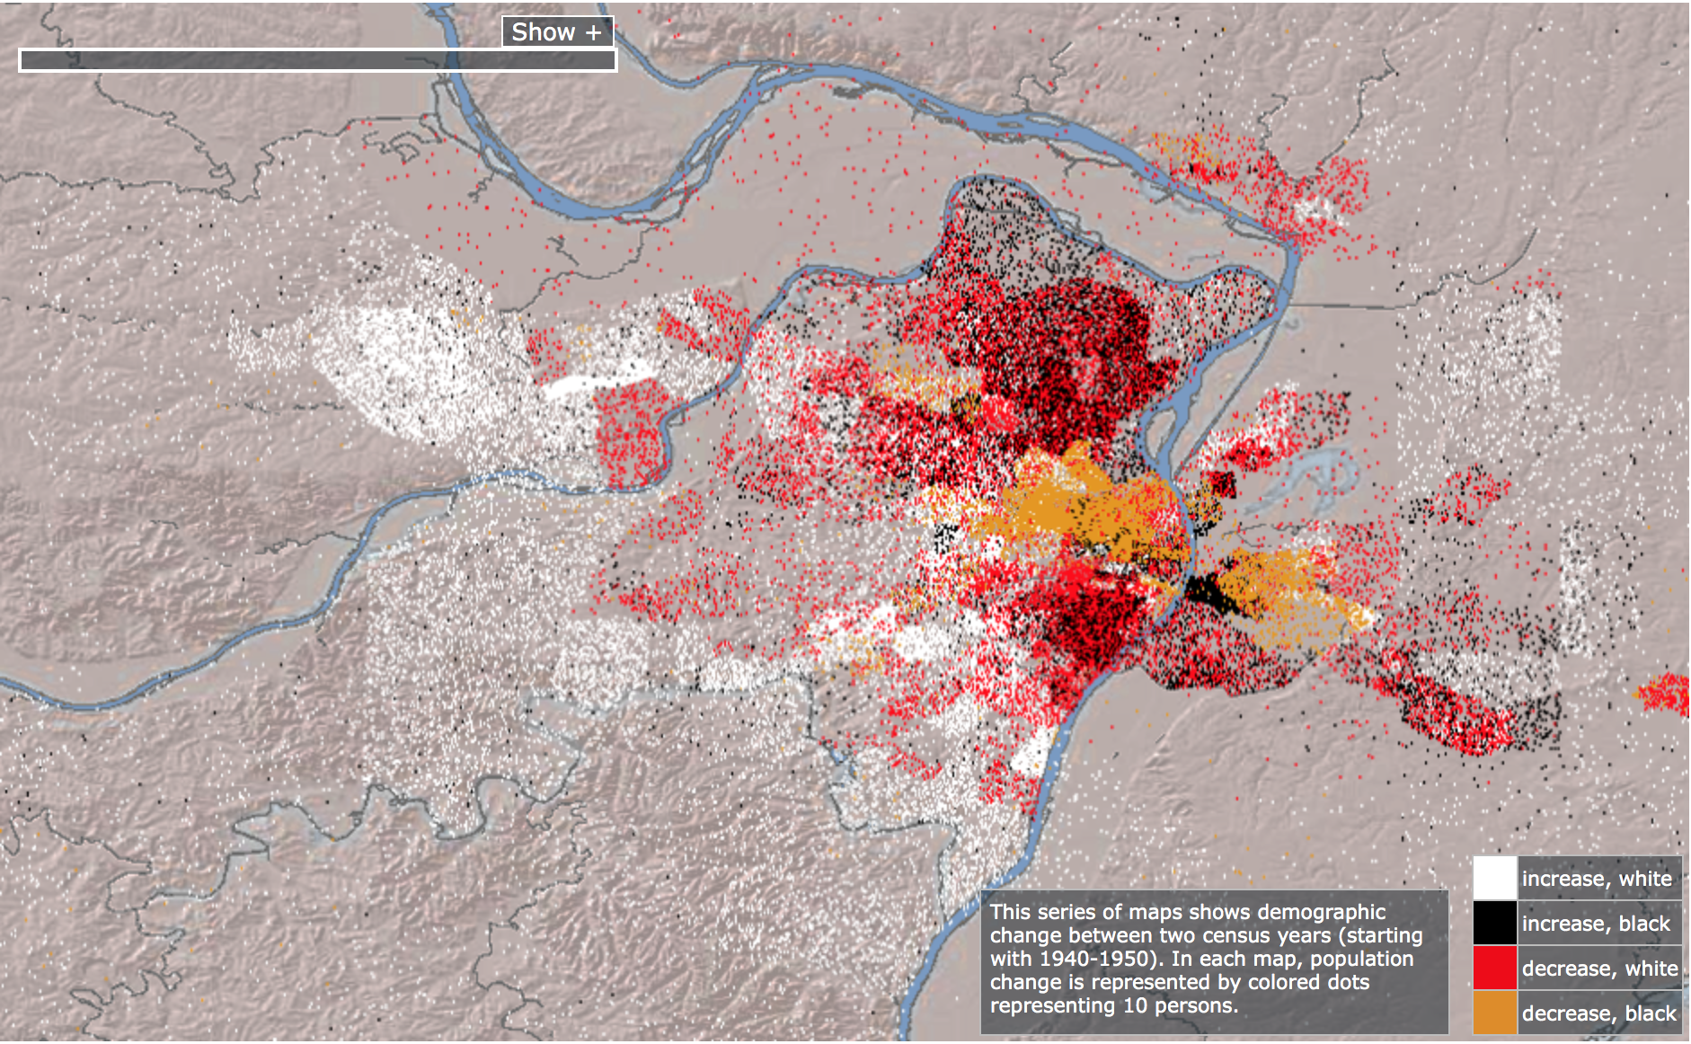
1990-2000:
Mapping Decline – St. Louis and the American City; Colin Gordon, The University of Iowa Libraries, Accessed Dec 3, 2017

Slide 10
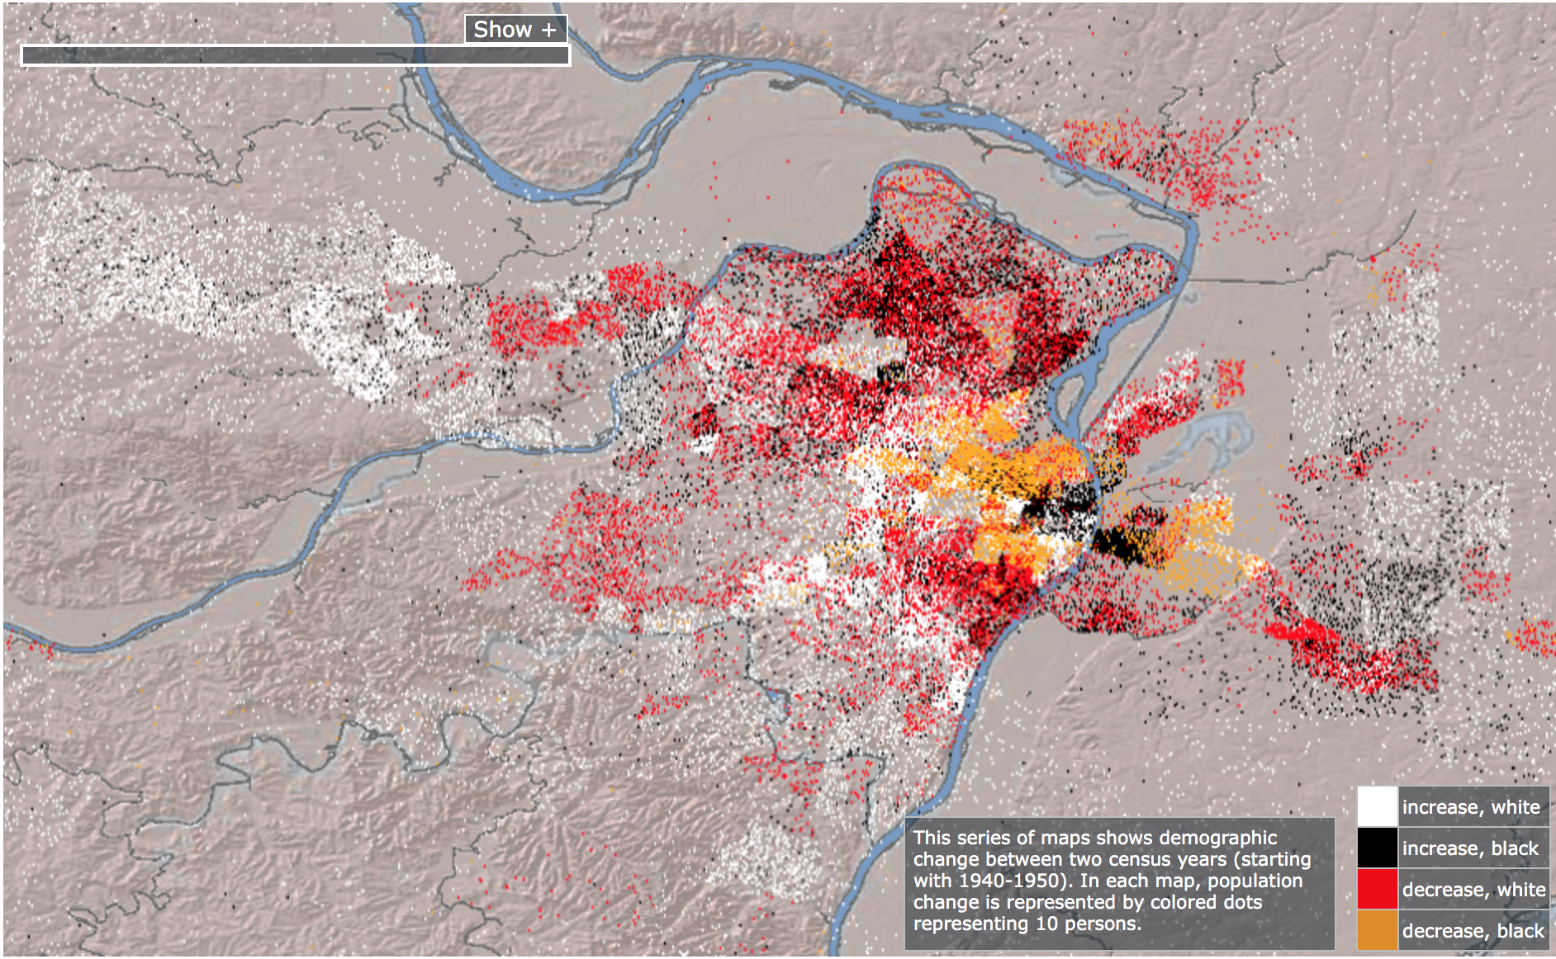
2000-2010:
Mapping Decline – St. Louis and the American City; Colin Gordon, The University of Iowa Libraries, Accessed Dec 3, 2017
Notes:
Sum this up

Slide 11
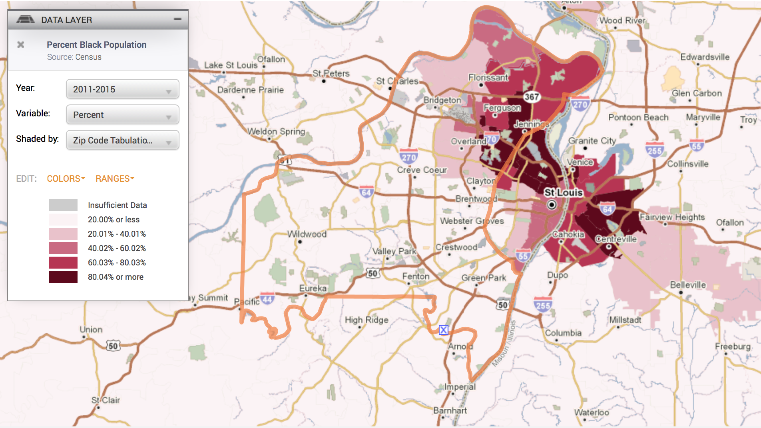
*Policy Map, Created Dec 3, 2017

Slide 12
Background: Historical Segregation in STL
At the time of the Brown v. Board decision, the St. Louis Board of Education was overlooking the second-largest segregated school district in the nation.
The Hickey Plan (1954)
Liddell v. Board of Education (1972) → VICC
Up until 1972, no comprehensive progress had been made towards integrating the SLPS district.
Notes:
Hickey Plan announced in 1954 as a response to the Brown decision, it was nowhere near as demanding and extensive as it needed to be to effectively desegregate the district
Up until 1972, no comprehensive progress had been made towards integrating the SLPS district
Liddell v. Board of Education resulted in the Voluntary Interdistrict Coordinating Committee in 1983, otherwise known as VICC, to oversee the creation of magnet schools in St. Louis City and the creation of a voluntary interdistrict busing initiative to desegregate the SLPS district (Heaney and Uchitelle, 2004, pg. 15).
The Hickey Plan – St. Louis Board of Education – Philip Hickey
Not as aggressive or comprehensive as it should have been
1954 – after Brown v. Board – three step desegregation plan created
Desegregation within SLPS schools – not successful, the same time that white flight increasing; no redrawing of school districts;

Slide 13
Establishing VICC
At it’s creation, VICC was the largest and most comprehensive desegregation plan in a Metropolitan area across the nation.
Voluntary Interdistrict Coordinating Council (VICC)
Established magnet schools within St. Louis City to encourage integration and draw white County students into SLPS.
Established the voluntary interdistrict transfer program to facilitate city students to enroll in county schools and county students within city magnet schools
Participating districts: Affton, Bayless, Brentwood, Clayton, Hancock Place, Kirkwood, Mehlville, Parkway, Rockwood, Valley Park, Webster Groves
Notes:
From its beginning to the initial stages of phase out in 1999, both aspects of the VICC program were extremely successful in encouraging desegregation in schools across the metropolitan area
Lindbergh is a special case

Slide 14
Strengths of VICC
VICC was successful in increasing minority enrollment in suburban schools and increasing desegregation across districts.
In the 1983-1984 school year,
Six participating suburban schools had student bodies composed of below 5% non-white students, and four schools had minority enrollments below 9% percent.
However, in the 1998-1999 school year, no participating suburban district had a minority enrollment less than 13%, and nine districts had boosted their non-white population to above 21%.
Furthermore, five years after the program started, 84% of teachers in participating transfer districts reported that transfer students had made significant academic progress at the transfer-district.
Additionally, the graduation rate of transfer students increased by two to three times at transfer districts, compared to graduation rates at city schools (even compared to city schools with high graduation rates).
Notes:
between 1983 and 1999, 52,000 students had participated in some aspect of the interdistrict transfer program
CONS: leadership structure, integration – leaving SLPS students to fail,
Funding and transportation
Furthermore, a staff exchange program that had originally been visualized by VICC to encourage teachers from the county and city to transfer to suburban districts or magnet schools was unrealized and never met its potential (Heaney and Uchitelle, 2004, pg. 131).
Any student with a discipline history was barred from participating in the transfer program (Heaney and Uchitelle, 2004, pg. 145).

Slide 15
Support of VICC
1988 polls by St. Louis Post Dispatch:
More resistance among white parents than their white children/students
Slim majority of white suburban parents supported VICC (54%)
71% of white students agreed that “it is a good idea to try to mix black city kids with white county kids.”
“Overwhelming support” among participating African American students and parents
The 1999 Settlement Agreement ended court supervision of VICC programing.
Initiated in a 25% phase out for the interdistrict transfer program, which began a subsequent decline in the amount of students able to enroll in the transfer program.

Slide 16
The National Post-Desegregation Paradigm
1980s: United States begins to shift away from formal desegregation policy and, instead, move towards promoting increased competition between public schools and the proliferation of school choice.
→ FUNDING
In between 1954, when Brown v. Board mandated school desegregation, and the late 1980s, schools across the nation, specifically those in the South, were the most integrated they had ever been.
Federally and state mandated desegregation policy is the only reliable method to get suburban, majority white, and affluent districts to pay attention to creating a diverse racial composition in schools.
Zooming Out:
Notes:
Furthermore, in 1981, during the Reagan Administration, the federal government eliminated the federal aid program for voluntary integration programs, essentially abandoning diverse, successful schools across the nation along with any hope of implementing a fully desegregated educational system (Orfield, 2009, pg. 7). Instead of cultivating integrated K-12 education, this federal aid was reallocated towards the creation of charter schools and school choice (Orfield, 2009, pg. 7).

Slide 17
Contemporary Implications of Between-District Segregation
Nationally and in St. Louis
*All Maps taken from Policy Map, created on Dec 3, 2017 – Data is from US News and World Reports, 2015

Slide 18
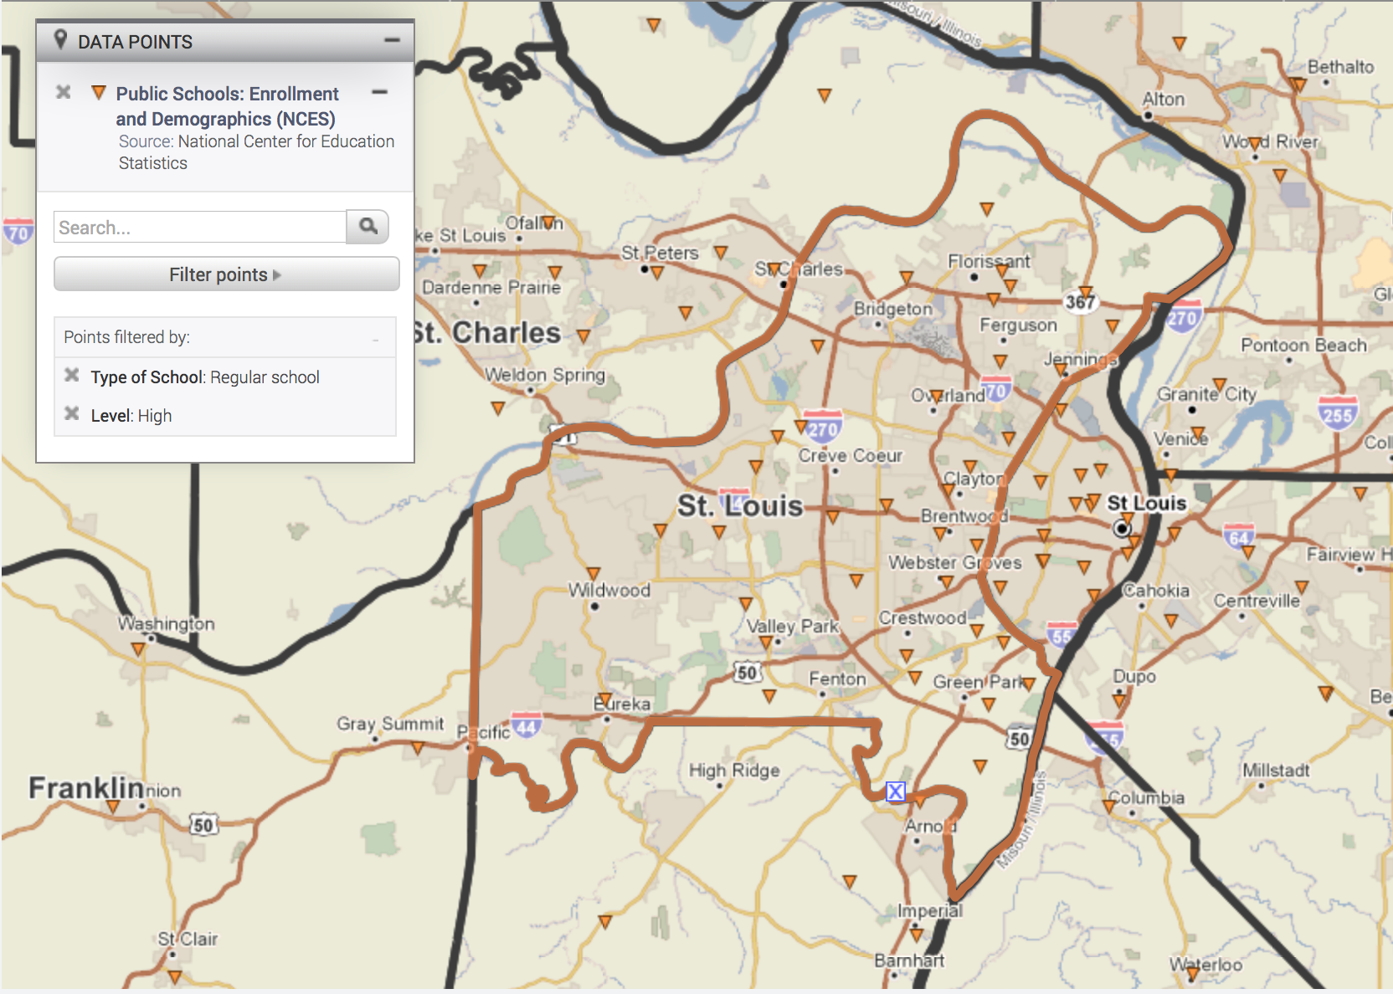
Confluence Preparatory Academy: 99% Minority Enrollment
The College Preparatory High: 100% Minority Enrollment
Lift For Life Academy High School: 92% Minority Enrollment
Carnahan School Of The Future: 94% Minority Enrollment
Roosevelt High: 87% Minority Enrollment
Beaumont Cte (Closed in 2014): 93% Minority Enrollment
Sumner High School: 99% Minority Enrollment
Soldan International Studies High School: 96% Minority Enrollment
Central Visual Performance Arts High School: 87% Minority Enrollment
Vashon High School: 100% Minority Enrollment
Grand Center Arts Academy High School: 71% Minority Enrollment
Metro Academic and Classical High School: 59% Minority Enrollment
Cleveland NjROTC Academy: 85% Minority Enrollment
Transportation and Law: 99% Minority Enrollment
Jennings High School: 100% Minority Enrollment
Riverview Gardens Senior High: 99% Minority Enrollment
Hazelwood Central High: 92% Minority Enrollment
McCluer North High: 81% Minority Enrollment
Northview (Special School District): 76% Minority Enrollment
McCluer High: 92% Minority Enrollment
McCluer South-Berkely High: 97% Minority Enrollment
Ritenour High School: 62% Minority Enrollment
Normandy High School: 98% Minority Enrollment
Hazelwood West High: 54% Minority Enrollment
University City High: 92% Minority Enrollment
Hazelwood East High: 98% Minority Enrollment
Several schools in St. Louis that serve a student body comprised of majority minority students.

Slide 19
In 1954: 7 all-white high schools 2 all-black high schools
16 public high schools that have a minority composition at or above 90%
St. Louis -- Index of Dissimilarity*
1968– 89.1
1990 – 62.6
2000 – 51.1
2010 – 57.9
2017 – 57.7
In recent years, “between-district” segregation has resulted in school districts that are either predominately white or non-white, with little to no diversity within the district.
In 2015:
*Index of Dissimilarity: a measure of the evenness with which two groups are distributed across a geographic space. A measure of 100 would mean complete segregation, 0 would mean there is complete evenness in racial distribution.

Slide 20
Racialized Opportunity Gaps*
Schools that serve majority-minority communities versus those that serve majority white students have stark disparities in curricular and extra-curricular resources. Schools with majority white composition have:
lower student-to-teacher ratios
increased access to challenging curriculum
More access to extracurricular activities
lower teacher turnover rates
Schools that serve majority low-income and majority minority students serve large percentages of students with persistent health and developmental problems, and are often located in areas that are highly disruptive and have low rates of residential stability.
*Opportunity Gaps: – the accumulated differences in access to key educational resources that support learning, both at home and at school, between schools and districts
Notes:
Residential stability: making it increasingly difficult for students to form sincere relationships with teachers and school staff

Slide 21
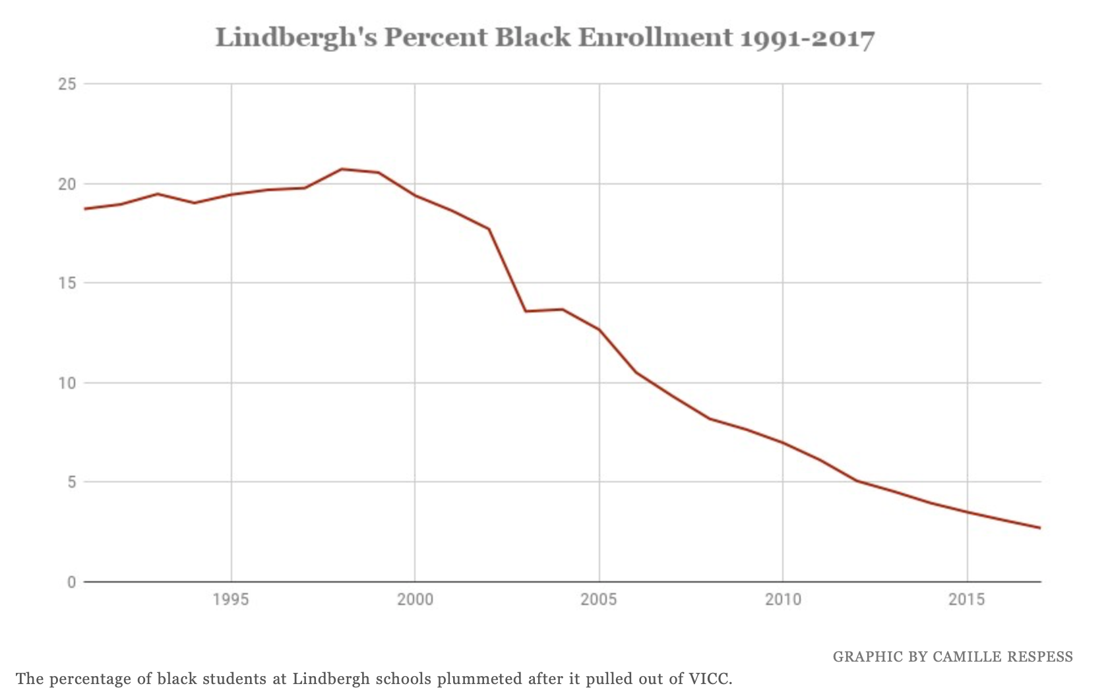
Lindbergh pulled out of VICC in 2016
1999: 20.56%
2017: Last VICC student graduates, black enrollment at 2.69%
“In the coming years, absent some sort of replacement transfer program, what's happening at Lindbergh could happen to districts across the county.”
*Taken from Riverfront Times

Slide 22
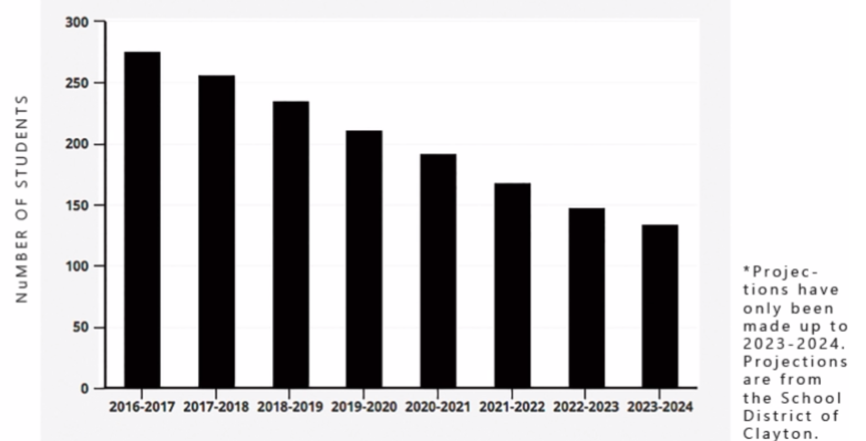
Projected Number of VST Students in Clayton
2023-2024
~6% of the district
*Graphic from The Globe using data from the School District of Clayton

Slide 23
Students Benefit from Integrated Classrooms
Desegregating schools based on race and income would benefit low-income students by providing access to peers/districts with high social capital and high levels of available resources.
In an increasingly diverse society, it is imperative to prepare children on how to interact with each other by fostering diverse classrooms.
Diversity fosters critical thinking skills, the development of “soft skills,” and the opportunity to communicate across racial lines, attributes that all students, even those at the top of the socioeconomic ladder with existing racial privilege, can benefit from.
The future of the nation is intertwined in the lives of its constituents, including minority and poor individuals. As society becomes increasingly diverse, and whites, for the first time, become a minority, it is even more important that students of color have access to a quality and equitable education.

Slide 24
Thinking Critically
Diversity for the sake of diversity is not the end goal
Desegregation is not integration
Final Question: What will the compositions of St. Louis schools look like without a comprehensive form of desegregation policy?
Notes:
Acknowledging shortcomings and asking the difficult questions
VICC has its benefits and its perks

Slide 25
Conclusion
At the time of Brown v. Board Decisions, the St. Louis Board of Education was overlooking the second-largest segregated school district in the nation.
VICC was successful in desegregating participating districts in the county through the Interdistrict transfer program and the creation of magnet schools.
Since the initial phase out of VICC in 1999, St. Louis residential patterns have continued to remain racially segregated, perpetuating segregated public school districts.
If VICC continues to be phased out without the introduction of another alternative program promoting desegregation, the enrollment of students of color in the Clayton School District will continue to decrease every year and STL will regress to a city where opportunity and education are segregated by race.

